Slide 1
Session 13.1 – Duties of the DBA
Databases Three - 2018

Slide 2
Intro to SQL Server
SQL server is a is a relational model database server developed by Microsoft
Uses T-SQL, proprietary extension to the SQL standard
Primary function is to store and manage data
Transaction based
Integrity of data is maintained
Notes:
SQL Server is a is a relational model database server currently developed by Microsoft. Like most Microsoft software the original code was developed by a company called SyBase, an German/American company.
SQL Server uses T-SQL, a proprietary extension to the SQL standard from SyBase and Microsoft. If any of you currently know “sql” from mysql ETC. you’ll be fine with T-SQL.
Primary function is to store and manage data with extreme Integrity. If any portion of the database object becomes corrupt, SQL Server will fail the entire database object.

Slide 3
Transactions
SQL Server = transactions
SQL Server manages these transactions to enable multiple concurrent connections
Everything is logged a transaction must be ACID
Atomic, consistent, isolated and durable
Notes:
Everything in SQL Server is completely transaction based, even administration tasks.
In a database system a transaction might consist of one or more data-manipulation statements, each reading and/or writing information in the database.

Slide 4
Transactions
Transaction process
Begin the transaction
Execute data manipulations and queries
If no errors occur then commit the transaction
If errors occur then rollback the transaction from logged data
Notes:
We will go further into database tractions later in the course

Slide 5
Duties of the DBA
Duties are unlimited within the scope of managing and maintaining the organizations data.
Knowledge required:
Installation configuration
Backup/Restore
Security
Maintenance
Reporting
Notes:
Unfortunately there is no limit to what defines a “DBA”. However, common tasks are….
Data management systems includes new database servers as well as database files, tables, rows and columns. Creating ERDs so you don’t get confused with what's going where
Getting the data could be creating a new front end form to importing a excel spreadsheet.
Maintain the data, this is security, availability and dealing with situations when data is unavailable

Slide 6
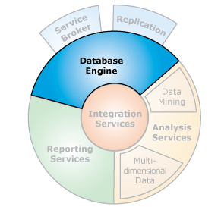
SQL Server components
Notes:
Each component is individual and usually requires a separate login to use. When someone talks about a “SQL Server”, they usually mean the database engine

Slide 7
Installation configuration
Database system
Operating system
Configuration – secpol, network, authentication
Security – physical, patch level secpol
Hardware
Configuration – RAID, resource pools
Reliability – Failover, clustering (HA, DRS)
Notes:
The database system itself has configuration, however so does the host operating system and hardware. You need to be able to configure these if required.
Operating system
No matter what host OS your running you still need to configure it. Some organizations will separate the sysadmin role with the DBA role however, you still need to know the basics
Physical security
Security config – reduce the attack surface
Network config – IPv4/6
Local/Domain authentication.
Hardware
You might be required to install/fix at a low level of detail storage or networking hardware. Be sure to understand your installed hardware

Slide 8
Backup/Restore
Understand:
Recovery models
Backup/restore tools
SQL statements for backup/restore
Adaptation for your needs
Notes:
As a DBA you need to understand that backups are something that is required, not something that ‘we should look into’ You need to understand the types of backups, what databases use what models and why.
When data losses occur, you need to get the backup restored ASAP. Many people will see this as your only job.

Slide 9
Backup Models
Full Recovery
Database and backup logs
Point in time recovery
Simple Recovery
Database file restores only
Not logged
Bulk-Logged
Temporary
Same as full, but for bulk queries
Notes:
There are two main backup models used by SQL Server, full and simple. The third, bulk-logged is a temporary solution for bulk inserts that otherwise would create a HUGE amount of logging. If a log backup contains any bulk-logged operations, you cannot restore to a point-in-time within that log backup; you can restore only the whole log backup. Because every transaction is logged, over time the log file will either become too big for your storage or full. Once the log is full, as some of you found out, nothing works on the database. You need to create a SQL backup job to backup and clear the log files to an external data storage object. Backups usually are required nightly depending on what sort of data changes occur.
Simple recovery model supports both database backups and file backups, which contain both user data and active transaction log data. But separate log backups are not supported, a database can be restored only to the end of the most recent backup for the data file (bitdev 6.30 and 7pm).

Slide 10
Scheduling Backups
SQL Server Agent
SQL Server Maintenance
SQL Jobs
Agent
Each job contains one or more steps
Each step contains its own task
Schedule, in response or on DBA demand
Notes:
SQL Server Agent is a Microsoft Windows service that executes scheduled administrative tasks, which are called SQL Server jobs. SQL Server Agent uses SQL Server to store job information.
Jobs contain one or more job steps.
Each step contains its own task, for example, backing up a database.
SQL Server Agent can run a job on a schedule, in response to a specific event, or on demand.
For example, if you want to back up all the company servers every weekday after hours, you can automate this task. Schedule the backup to run after 22:00 Monday through Friday; if the backup encounters a problem, SQL Server Agent can record the event and notify you.
SQL Server database engine has its own tool for running backups. SQL Server Jobs via the maintenance wizard. We will create a job later

Slide 11
Security - Principals
Principals are entities that can request SQL Server resources.
Windows-level principals
Windows Domain Login
Windows Local Login
SQL Server-level principal
SQL Server Login
Database-level principals
Database User
Database Role
Application Role

Slide 12
Principals 2 – Sort of
INFORMATION_SCHEMA and sys
Every database includes two entities that appear as users in catalog views: INFORMATION_SCHEMA and sys. These entities are required by SQL Server. They are not principals, and they cannot be modified or dropped (deleted).

Slide 13
Security
Authentication models
Windows Authentication
Uses the windows account
Secure – trusted security
SQL Server
SQL Server Authentication is provided for backward compatibility
Uses a separate username/password
No Kerberos security
Uses SA (systemAdministrator)
Notes:
SQL server has two authentication modes, Windows authentication and SQL Server authentication. Windows auth uses the local windows user or the logged on domain user SID for authorization on the SQL engine. SQL Server authentication is handled completely by SQL server itself.
When a user connects through a Windows user account, SQL Server validates the account name and password using the Windows principal token in the operating system. This means that the user identity is confirmed by Windows. Windows authentication is more secure as you have to be logged into the domain\server to use it.
SQL authentication is useful for working on the server where you’re not able to use Windows E.G at home

Slide 14
Security 2
Logins
Can be Windows
Or SQL Server
Users
A login on a database
Notes:
Once you have your authentication model sorted out, you can create a login. A login is a person’s account on SQL Server that will have rights and permissions granted to it. If you use a Windows auth login, It will be prefixed with the domain, E.G OPNET\NathanR
A user is a login assigned to a database. You must create a database user with a valid login

Slide 15
Identifiers
When a SQL Server login is created, it is assigned an ID and a SID
Useful views and SP’s
sys.server_principals
exec sp_helpdb
exec sp_helplogins
exec sp_helpuser
Notes:
When a SQL Server login is created, it is assigned an ID and a security ID. These are visible in the sys.server_principals catalog view as principal_id and SID. The ID (principal_id) identifies the login as a securable within the server. It is assigned by SQL Server when the login is created. When a login is deleted, its ID number is recycled. The SID identifies the security context of the login and is unique within the server instance. The source of the SID depends on how the login is created. If the login is created from a Windows user or group, it is given the Windows SID of the source principal; the Windows SID is unique within the domain. If the SQL Server login is created from a certificate or asymmetric key, it is assigned a SID derived from the SHA-1 hash of the public key. If the login is created as a legacy-style SQL Server login that requires a password, the server will generate a SID.

Slide 16
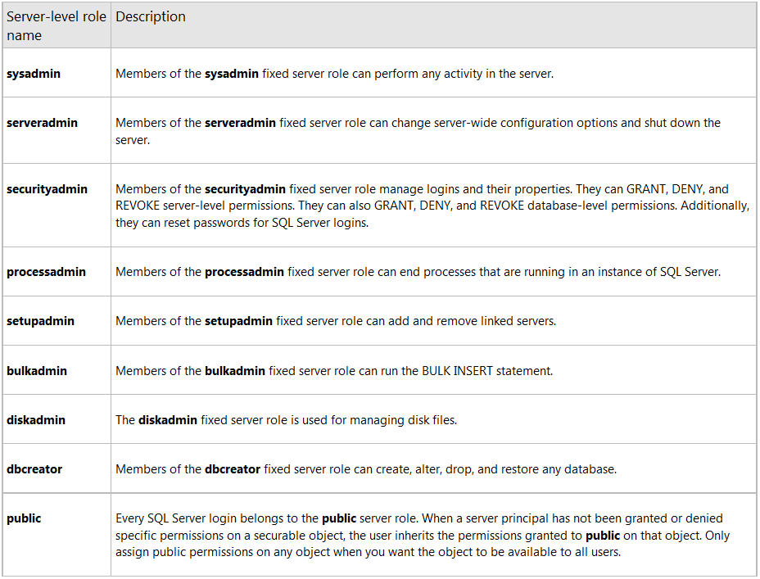
Permissions - Server

Slide 17
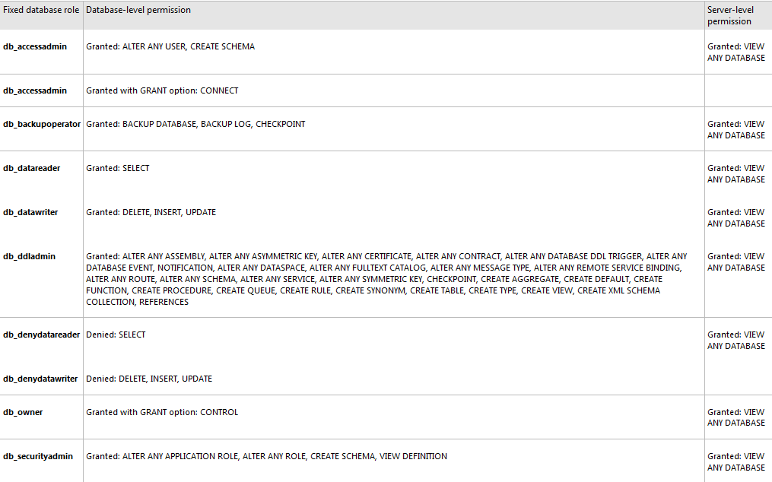
Permissions - Database
Notes:
Explain the public database role

Slide 18
Working with Permissions
Feature | Type | Description
sp_helpsrvrole | Metadata | Returns a list of server-level roles.
sp_helpsrvrolemember | Metadata | Returns information about the members of a server-level role.
sp_srvrolepermission | Metadata | Displays the permissions of a server-level role.
IS_SRVROLEMEMBER | Metadata | Indicates whether a SQL Server login is a member of the specified server-level role.
sys.server_role_members | Metadata | Returns one row for each member of each server-level role.
sp_addsrvrolemember | Command | Adds a login as a member of a server-level role.
sp_dropsrvrolemember | Command | Removes a SQL Server login or a Windows user or group from a server-level role.

Slide 19
Maintenance
SQL Server jobs and alerts
DBCC commands
dbcc checkdb
dbreindex
checkcatalog
inputbuffer
sp_who
sp_kill

Slide 20
Reporting
ad hoc reporting
Standard reports
NOT SSRS
A manager wants a list of all the databases, and who has select and update permissions

Slide 21
Pages and Extents
Fundamental unit of data storage in SQL Server is the page
Disk space allocated to a data file in a database is logically divided into pages
Numbered contiguously from 0 to n
Disk I/O operations are performed at the page level
Extents are a collection of eight contiguous pages
All pages are stored in extents
Log files do NOT contain pages; they contain a series of log records.
Notes:
The fundamental unit of data storage in SQL Server is the page. The disk space allocated to a data file (.mdf or .ndf) in a database is logically divided into pages numbered contiguously from 0 to n. Disk I/O operations are performed at the page level. That is, SQL Server reads or writes whole data pages.
Extents are a collection of eight physically contiguous pages and are used to efficiently manage the pages. All pages are stored in extents.

Slide 22
Pages
Page size is 8 KB
Databases have 128 pages per megabyte
Header is 96 bytes
Page number
Page type
Free space
Who owns the page
Notes:
In SQL Server, the page size is 8 KB. This means SQL Server databases have 128 pages per megabyte. Each page begins with a 96-byte header that is used to store system information about the page. This information includes the page number, page type, the amount of free space on the page, and the allocation unit ID of the object that owns the page.

Slide 23
Page Types
Data
Data rows with all data except
text
Ntext
Image
nvarchar(max)
varchar(max)
varbinary(max)
XML data when text in row is set to ON.

Slide 24
Page Types
Text/Image
Large object data types
text, ntext, image, nvarchar(max), varchar(max), varbinary(max), and all other xml data
Variable length columns when the data row exceeds 8 KB
varchar, nvarchar, varbinary, and sql_variant

Slide 25
Page Types
Index
Index entries

Slide 26
Page Types - other
Global Allocation Map
Information about whether extents are allocated.
Page Free Space
Information about page allocation and free space available on pages.
Index Allocation Map
Information about extents used by a table or index per allocation unit.
Bulk Changed Map
Information about extents modified by bulk operations since the last BACKUP LOG statement per allocation unit.
Differential Changed Map
Information about extents that have changed since the last BACKUP DATABASE statement per allocation unit.

Slide 27
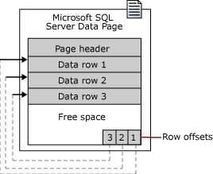
Pages
Data rows are put on the page serially after the header
Notes:
Data rows are put on the page serially, starting immediately after the header. A row offset table starts at the end of the page, and each row offset table contains one entry for each row on the page. Each entry records how far the first byte of the row is from the start of the page. The entries in the row offset table are in reverse sequence from the sequence of the rows on the page.

Slide 28
Extents
Extents are the basic unit in which space is managed
An extent is eight physically contiguous pages
Notes:
Extents are the basic unit in which space is managed. An extent is eight physically contiguous pages, or 64 KB. This means SQL Server databases have 16 extents per megabyte.
To make its space allocation efficient, SQL Server does not allocate whole extents to tables with small amounts of data. SQL Server has two types of extents:
Uniform extents are owned by a single object; all eight pages in the extent can only be used by the owning object.
Mixed extents are shared by up to eight objects. Each of the eight pages in the extent can be owned by a different object.
A new table or index is generally allocated pages from mixed extents. When the table or index grows to the point that it has eight pages, it then switches to use uniform extents for subsequent allocations. If you create an index on an existing table that has enough rows to generate eight pages in the index, all allocations to the index are in uniform extents.

Slide 29
Extents and tables
To simplify
Rows of data go on pages
Pages are grouped into extents
What happens if there is an table with little data?
SQL Server has two types of extents
Uniform extents filled by one table (eight pages)
Mixed extents are shared by up to eight tables
Each of the eight pages in the extent can belong to a different table
Notes:
A new table or index is generally allocated pages from mixed extents. When the table or index grows to the point that it has eight pages, it then switches to use uniform extents for subsequent allocations. If you create an index on an existing table that has enough rows to generate eight pages in the index, all allocations to the index are in uniform extents.

Slide 30
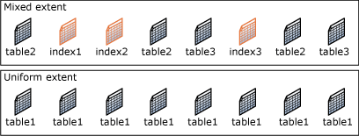
Extents

Slide 31
SQL scripts
CRUD statements
table, view, UDF, triggers, stored procedures
SQL control
If, else, begin, end, while, break, case
SQL functions
@@identity, @@spid, substring, cast, convert
System functions
Notes:
Create, Read, Update and Delete (CRUD) are the four basic functions of persistent storage (data that outlives the process that created it. Without this capability, data would only exist in RAM, and would be lost when power is removed.
Create INSERT
Read SELECT
Update UPDATE
Delete DELETE

Slide 32
Becoming a DBA
Understand the daily tasks
Grasp the necessary skills for these tasks
SQL syntax and scripts for moving data
Practice, then more practice

